Slide 1
Epam Project
Nail Kamaleev

Slide 2
Приложение
Nginx
PHP
MySQL
Front-end:
1. Display any portion of the data stored in the DB
2. Provide a method to trigger data update process
Back-end:
1. Retrieve a portion of data from
API and store it in a database
2. Update data on demand
Database:
1. Choose Database type and data scheme in a suitable manner.
2. Data must be stored in a persistent way
3. It’s better to use cloud native DB solutions like an RDS/AzureSQL/CloudSQL.

Slide 3
API
Using API https://affiliate.itunes.apple.com/resources/documentation/itunes-store-web-service-search-api/ get all data about “Pink Floyd" and store it into your DB:
kind, collectionName, trackName, collectionPrice, trackPrice, primaryGenreName, trackCount, trackNumber, releaseDate.
Output the data for the year of releaseDate (the year is set) in the form of a table and sort them by trackPrice in descending order.

Slide 4
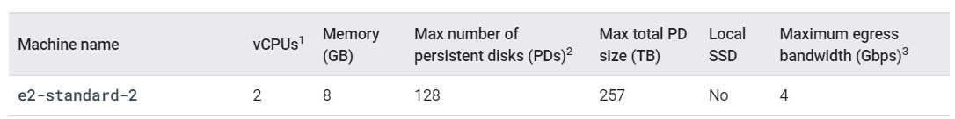
Подготовка 1
main.tf
GCP
Создаем в GCP с помощью Terraform:
кластер в зоне “europe-north1-b”
три ноды с типом машин “e2-standard-2”
регистри

Slide 5
Подготовка 2
С помощью yaml манифестов разворачиваем в кластере:
Jenkins
GitLab
Sonar
Prometheus
EFK
Создаём две БД MySQL в GCP:
itunes_database
itunes_database_prod

Slide 6
Общая схема
PUSH
GCP
GKE
Sonar
DB_DEV
Pinfloyd-DEV
GitHub
Jenkins
EFK
Pinfloyd-PROD
DB_PROD
Prometheus
Registry
Notes:
Connecting to SQL from GKE using the Cloud SQL Auth proxy (sidecar container)

Slide 7
Pipeline
Stage “Code test”
Stage “Image build”
Stage “Deploy to DEV”
Stage “Deploy to PROD”
Post - оповещение

Slide 8
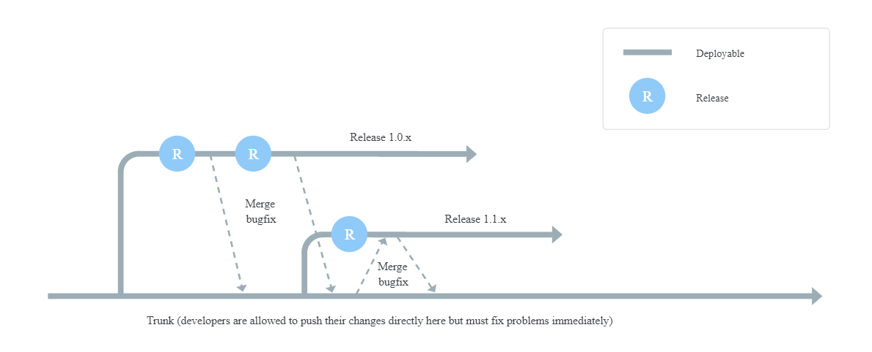
Стратегия разработки - Trunk-Based Development

Slide 9
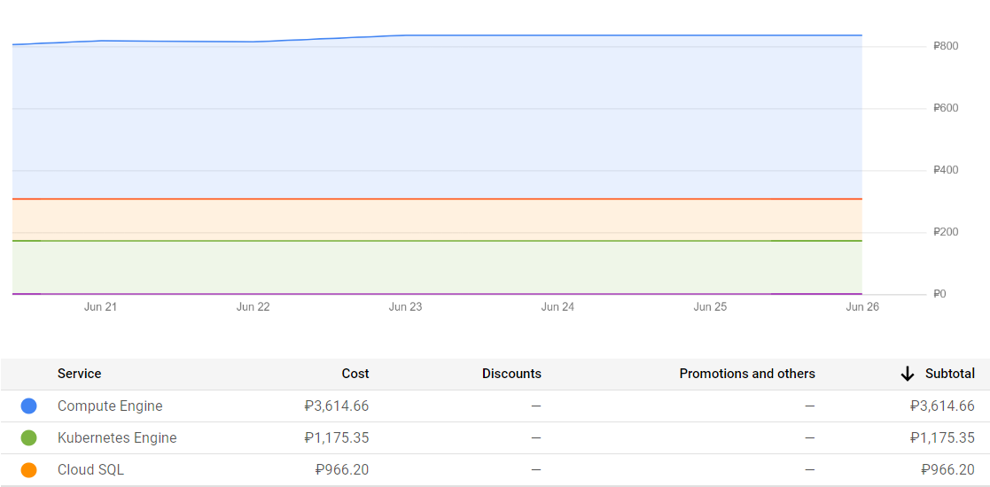
Затраты за неделю (20.06.21-26.06.21)

